Slide 1
Re-Learning the Alphabet
The words that go with the community acronym and what they all mean

Slide 2
“The Acronym” Itself
LGBT
LGBT+
LGBTQ
LGBTQIAP
LGBTQQIAAP

Slide 3
Let’s get into the alphabet soup:
In order of appearance, and some more information to follow!

Slide 4
Lesbian
A woman who is attracted to women (or “WLW,” short for “women who love women”); INCLUSIVE of trans women and nonbinary folx
Reference to the Island of Lesbos, where poet Sappho wrote romantical poetry about women
Word was popularized in the mid-20th century to distinguish the experience of WLW from the experience of MLM

Slide 5
Gay
Word developed in reference to men who are attracted to men (“MLM,” short for “men who love men”)
Became shorthand for all LGBT+ folx
NOTE: “Gay” is often preferred to “homosexual” because “homosexual” has come to be remembered as pathologizing same-sex attraction; however, it is still preferred by some.

Slide 6
Bisexual
“Bi” – two
NOTE: Bisexuality does not imply that there are only two genders, or that a bisexual person can only be attracted to two genders
The Bisexual Manifesto was written in 1990, affirming that bisexuality means attraction to more than one gender
Personal definitions may differ slightly

Slide 7
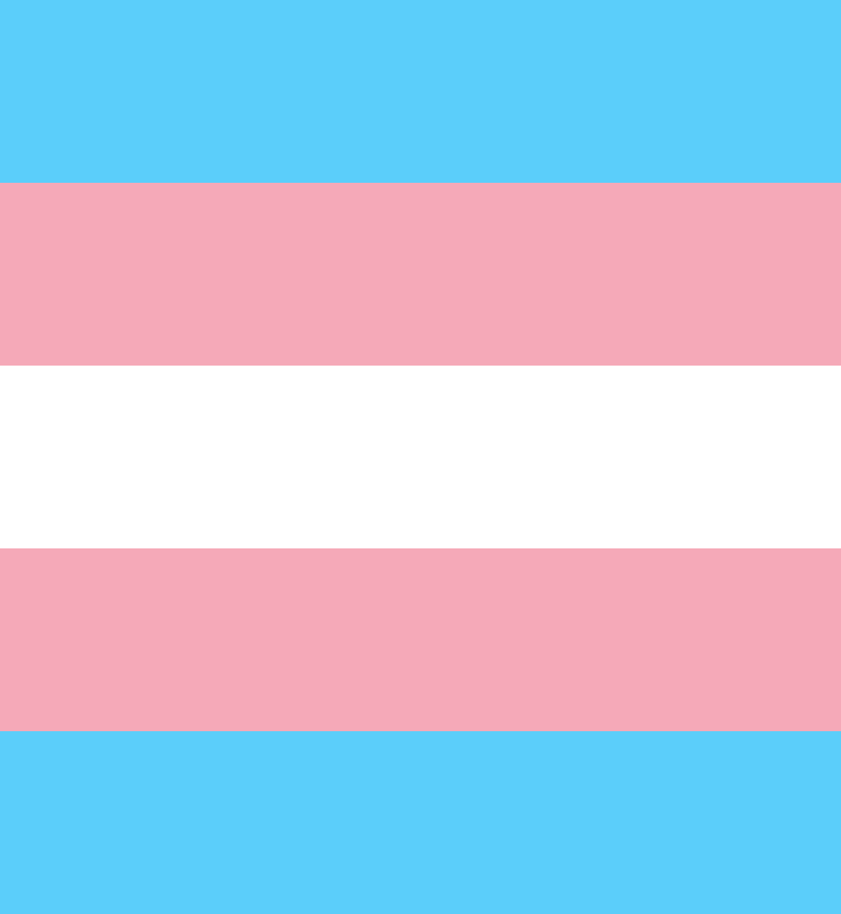
Transgender
“Trans” – across, beyond, through
A person whose gender does not match the one assigned at birth
There are binary and nonbinary transgender people
“Dysphoria” – anxiety, depression, “wrongness,” incongruence
“Euphoria” – feeling of rightness, wholeness
“Transgenders,” “Transgendereds” – not a thing
“Transsexual” – outdated and considered by many to be offensive, but there are those who do use transsexual.

Slide 8
Queer
Common referential word in academic sphere
Used by many people who for one reason or another do not wish to specify
A general term meaning “not straight” or “not cisgender”

Slide 9
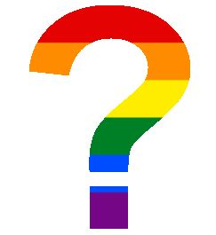
Questioning
Being uncertain of whether a label fits
Not always talked about in a positive light – this is not helpful.
Questioning is totally okay! If you are unsure, you explore what feels most comfortable for you, and you may find that another label fits better than you ever could have known; otherwise, you learn that you were right the first time and have simply gained a different appreciation for the experiences of others. :)

Slide 10
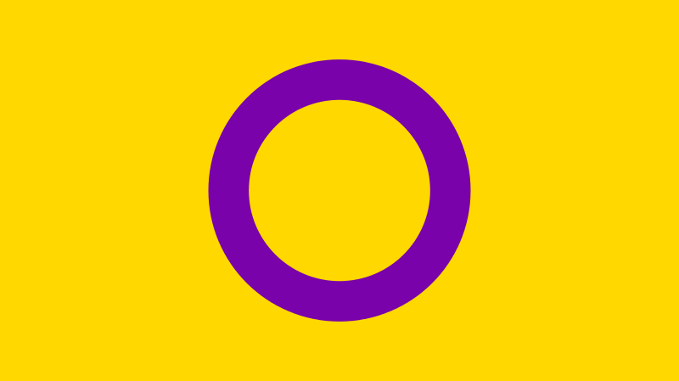
Intersex
Included in some iterations of the acronym for recognition of sexes outside the dimorphic “norm”
NOTE: not all intersex people identify as LGBT+
By recent research, about 1.7% of people are intersex – just as common as redheads!

Slide 11
Asexual
“A” – none
A person who feels no sexual attraction
There are asexual people who are sex-repulsed, sex-neutral, or sex-positive; the unifying factor is that they do not feel sexual attraction.
Just how sex can happen without love, love can happen without sex

Slide 12
Pansexual
“Pan” – all
Similar to bisexuality in that attraction is felt for more than one gender, distinct in that bisexual people may be attracted to some but not all

Slide 13
Aromantic
A person who feels no romantic attraction
An aromantic person is NOT any less capable of forming friendships or familial bonds, they simply do not form romantic attachments

Slide 14
Some other terms of note:
Let’s compare some “bad words” to present, more appropriate points of reference, and some other vocab words that are not featured in the acronym.

Slide 15
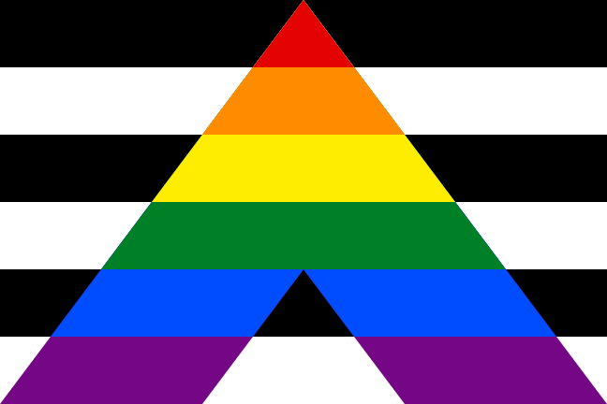
Ally
While greatly appreciated, NOT part of any LGBT+ acronym
Allies are people who are all four: cisgender, perisex (non-intersex), heterosexual, heteroromantic. This may be abbreviated to cishet.
Cishet is not a slur, it is shorthand. While it may be used by LGBT+ people (and particularly by trans people) to express frustration with people who are not allies, it is not inherently nor is it intended to be a derisive word.

Slide 16
Folx
A spelling of the word “folks” that uses an “x” to denote gender nonconformity or specifically marks recognition of and inclusion of queer/trans people
Not used often even within the community, but now you know if you encounter “folx” in the wild! :)

Slide 17
Gender Imperialism
Our conceptions of a gender binary are very Western; none of these examples have direct parallels in reference to our binary system. Thus, the gender binary is sometimes referred to as gender imperialism.
Some Native cultures such as Navajo recognize Two-Spirit people, though by nation there are different interpretations of gender. In India, there is a population of Hijra. Mahu are part of a native Hawai’ian culture. Waria live in Indonesia.

Slide 18
Marriage Equality
Defense of Marriage Act (DOMA) – defined marriage as between one man and one woman; declared unconstitutional by President Barack Obama in 2013
Signed into national law in 5-4 decision on Supreme Court case Obergefell v. Hodges on 6/26/2015
However, while equal rights are said to be given, benefits are still not given to people who are disabled, polyamorous, or under the poverty line

Slide 19
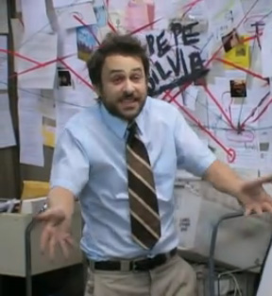
Orientation
Romantic – those to whom one feels romantic attraction
Sexual – those for whom one feels sexual attraction
Romantic and sexual orientations do not always line up! Someone might be heteroromantic and asexual, biromantic and homosexual, aromantic and pansexual, etc etc!

Slide 20
Name and Pronouns
NOTE: Some people do use more than one set of pronouns. These people may have a preferred set or use different pronouns in different contexts/environments.
NOTE: While pronouns are often indicative of one’s gender identity, they are not exclusive to any one identity.
Playing around with pronouns is okay and fun!! Not only that, but experimentation with language and identity is a way to make the world a little safer for those whose genders or orientations are less well-regarded to publicly talk about their experiences.
“Preferred” implies that the person is okay with people using either the name given at birth or the pronouns associated with their assigned gender, and for most transgender people, this is NOT the case
Simply calling them “name and pronouns” understands that a transgender person’s name and pronouns are the correct ones and not an option

Slide 21
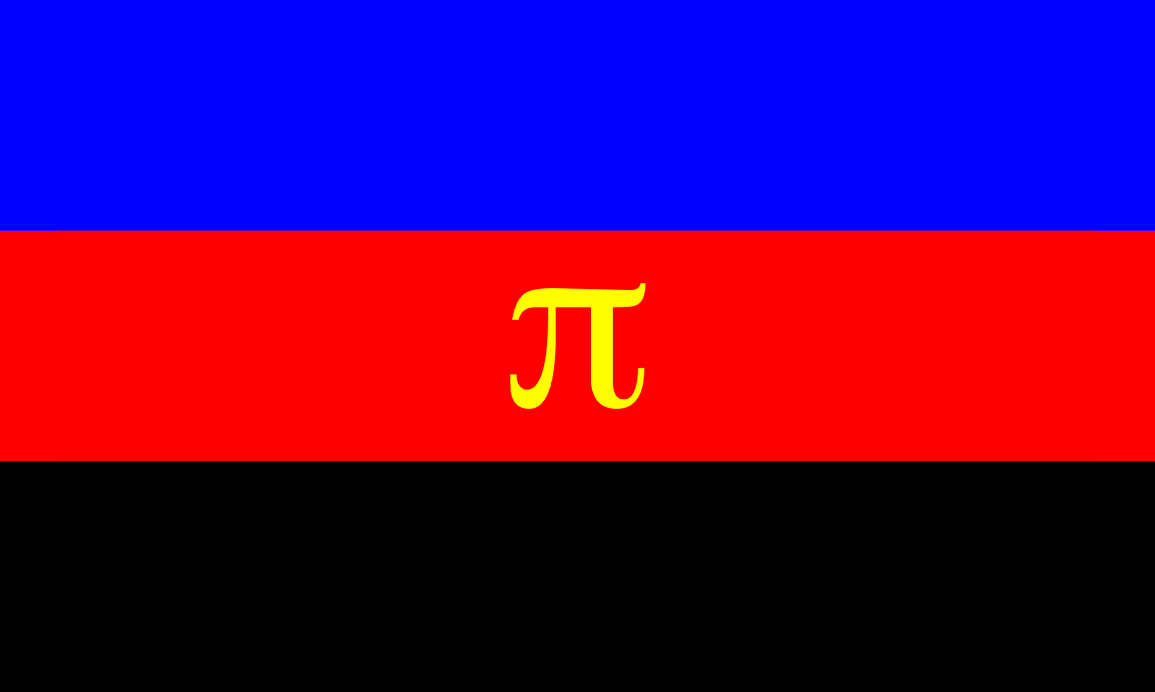
Polyamorous
Ethical Non-Monogamy is the umbrella term under which Polyamory falls, because ENM does not want to presume romanticism but includes other dynamics.
Example: Queerplatonic Relationship (QPR)
Finding fulfillment in having relationships with more than one person
ALL parties are FULLY KNOWING and CONSENTING; otherwise, that is simply cheating

Slide 22
Straight
“Hetero” – different
Heterosexual is not a word that has been used to pathologize or otherize
Straight is not a slur
Also not included in LGBT+ acronyms
NOTE: Trans people can be straight! A trans man who is attracted only to women (trans or cis) is a straight man; similarly, a trans woman who is only attracted to men (trans or cis) is straight.

Slide 23
Umbrella – includes multiple identities
Trans – binary, nonbinary.
Nonbinary – including but not limited to genderfluid (gender changes), agender (having no gender), third-gender (a strong alignment outside of man or woman), etc
Ace/Ace-Spec – asexual (no sexual attraction), demisexual (sexual attraction forms only after deep attachment), greysexual (very very rare sexual attraction), etc
Aro/Aro-Spec covers similar sub-labels.
Bi – bisexual (attracted to multiple genders), pansexual (attracted to all genders), polysexual (attracted to more than one but expressly not all genders), etc

Slide 24
Resources
https://www.hrc.org/our-work/stories/the-journey-to-marriage-equality-in-the-united-states
https://www.glaad.org/reference/lgbtq
https://www.intersexequality.com/how-common-is-intersex-in-humans/
http://download.elca.org/ELCA%20Resource%20Repository/FAITH_SEXISM_JUSTICE_Conversations_toward_a_Social_Statement.pdf?_ga=2.101634502.699408884.1570846810-1892126616.1570846810
Polysecure - Jessica Fern
More than Two - Franklin Vaux, Eve Rickert

